Slide 1
Expansion microscopy
-presented by 王诗仪，王梦琪，李钰昕，莫悦剑

Slide 2
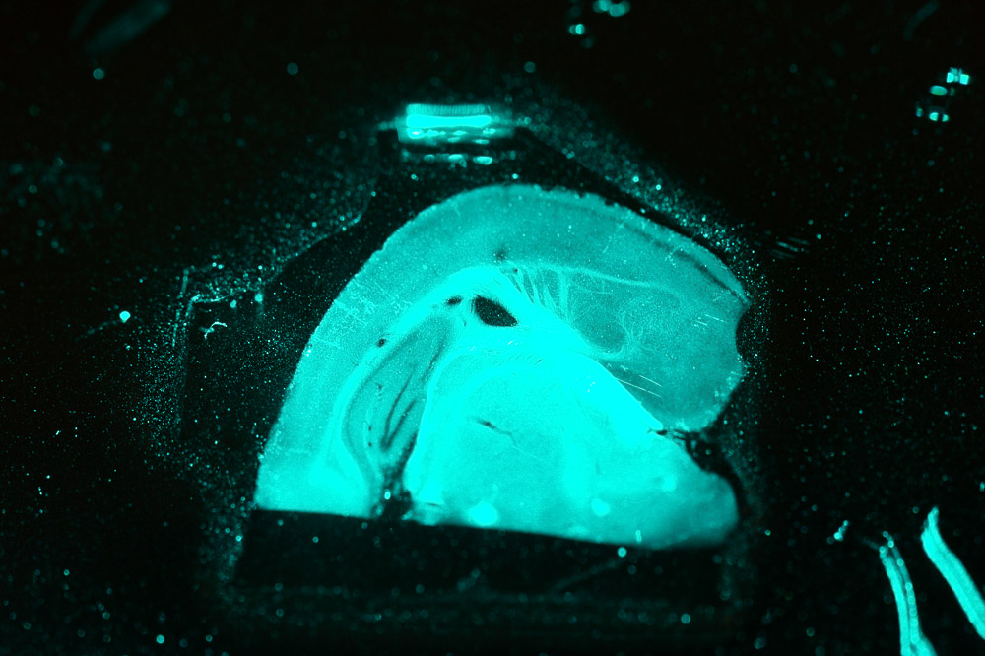
OUTLINE
Background (with a small lab )
Lab design
Quality Report
Application

Slide 3

https://www.media.mit.edu/people/esb/overview/
Notes:
He leads the Synthetic Neurobiology group, which develops tools for analyzing and repairing complex biological systems such as the brain, and applies them systematically to reveal ground truth principles of biological function as well as to repair these systems
He co-directs the MIT Center for Neurobiological Engineering, which aims to develop new tools to accelerate neuroscience progress.
optogenetic tools

Slide 4
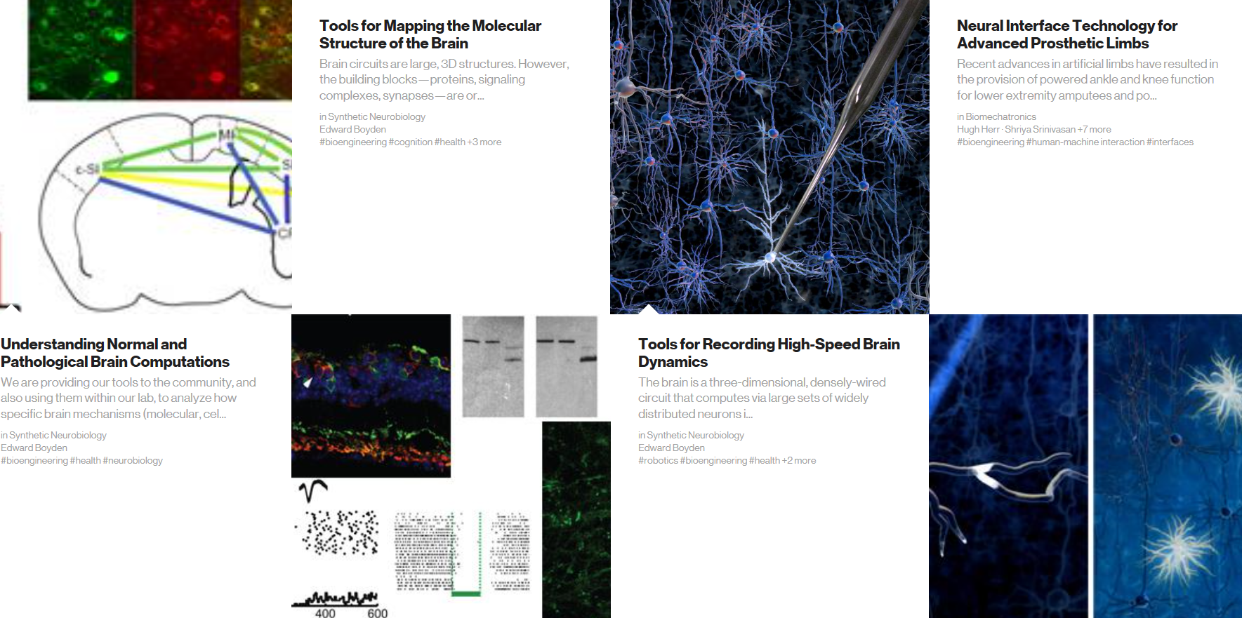
Lab Programs
Notes:
They do something using a material that is swellable. Which is also a material made of baby diaper.

Slide 5
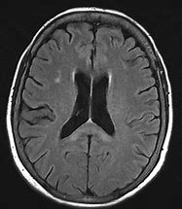
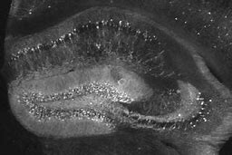

Expansion“microscopy”
Based on present microscopes
Expanse the specimen rather than the resolution of microscopy
The entire, process of labeling, gelation, digestion, expansion, and imaging we call expansion microscopy
Notes:
From the first microscope was designed, we have many kinds of microscopes to help scientists observe the structure of the target.
Now, we don't know how the neurons in the brain are organized to form networks, and we don't know how the biomolecules are organized within neurons to form these complex, organized machines
MRI (magnetic resonance imaging): not the resolution where it can pinpoint the molecular changes that occur or the changes in the wiring of these networks that contributes to our ability to be conscious and powerful beings.
But light is fundamentally limited. You can't see individual molecules with a regular old microscope. You can't look at these tiny connections. So if we want to make our ability to see the brain more powerful, to get down to the ground truth structure, we're going to need to have even better technologies.

Slide 6
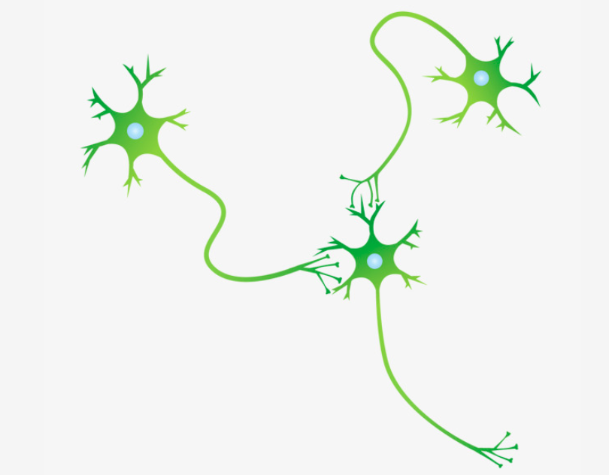

Design of Expansion
Step1: Attach target biomolecules to a little anchor
Function: Bind the polymers for further polymerization
Notes:
After knowing that the expansion microscopy is to expand the specimens
how to link the material to the target biomolecules
The first step is to establish a bridge between the acrylate polymers with the target sites
Here is an anchor

Slide 7

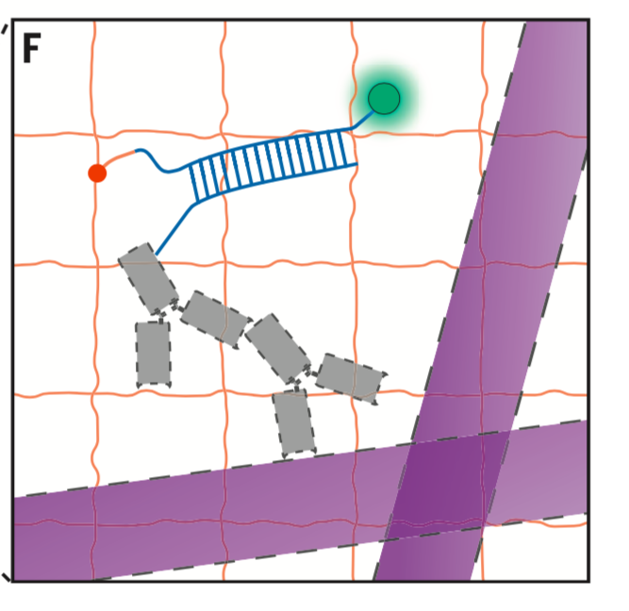

How to construct a specific “Anchor”?
Primary antibody
Figure: Schematic “anchor” between biomolecules with polymers
Notes:
How to construct the specific anchor?
Let’s see this seeming redundancy but in fact sophisticated product
Primary antibody binds to the target sites such as protein-the microtubule

Slide 8

How to construct a specific “Anchor”?
Secondary antibody
antibody+ssDNA sequence
Figure: Schematic “anchor” between biomolecules with polymers
Notes:
Then the secondary antibody specifically binds to the pa
this secondary antibody possess a single strand oligonucleotides with specific sequence

Slide 9


How to construct a specific “Anchor”?
Tri-functional label
ssDNA sequence
Fluorophore
5’ Acrydite modification
Figure: Schematic “anchor” between biomolecules with polymers
Notes:
tri functional label contains ssdna sequence binds to the complementary sequence in the secondary antibody
Fluorophore is used for visualized target position
and 5’ acridte modification attaches to the monomers so as to
DNA sequence is easier to be modified so as to gain the capacity of binding monomers

Slide 10
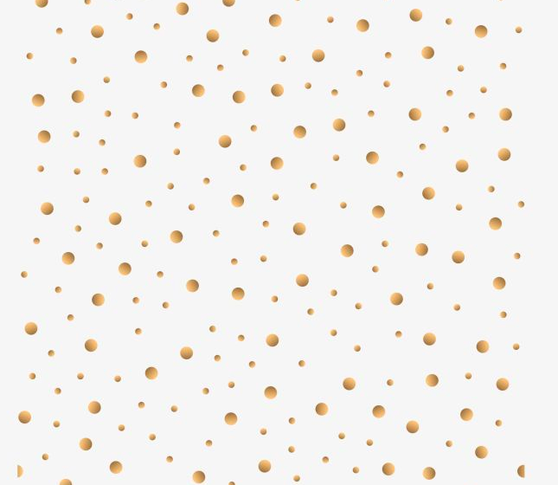
Design of Expansion
Step2: Let the building blocks, monomers, go into the brain- further form long chains-run along/cross molecules and form complicated network
Aim: Avoid the whole polymers just floating on the surface
Function: Polymers can bind the anchors. The network will pull apart the target biomolecules
Notes:
After put in anchor
We need to add the swellable material inside
The large polymers would float on the surface of the tissues
Thus we choose the monomer
this monomer can auto polymerization after adding the app and TEMED

Slide 11
Design of Expansion
Step2: Let the building blocks, monomers, go into the brain- further form long chains-run along/cross molecules and form complicated network
Aim: Avoid the whole polymers just floating on the surface
Function: Polymers can bind the anchors. The network will pull apart the target biomolecules

Slide 12
Design of Expansion
Step2: Let the building blocks, monomers, go into the brain- further form long chains-run along/cross molecules and form complicated network
Aim: Avoid the whole polymers just floating on the surface
Function: Polymers can bind the anchors. The network will pull apart the target biomolecules

Slide 13

Design of Expansion
Step2: Let the building blocks, monomers, go into the brain- further form long chains-run along/cross molecules and form complicated network
Aim: Avoid the whole polymers just floating on the surface
Function: Polymers can bind the anchors. The network will pull apart the target biomolecules

Slide 14
Design of Expansion
Step3: Add water
Function: Polyelectrolyte gel expansion
Notes:
Finally
we add water to make the swellable material bigger and bigger

Slide 15
How to preserve their natural configuration?
Tips: Protease
Homogenize
Elimination

Slide 16
Does Expansion Microscopy work?
Devices to quantify:
Confocal Microscope, SR-SIM
Specimens for testing:
Cell(HEK293), Tissues(Mammalian Brain)
(~60μm) ()
Features of quantification
Isotropy, Measurement Error, Effective resolution, sharpness, speed

Slide 17
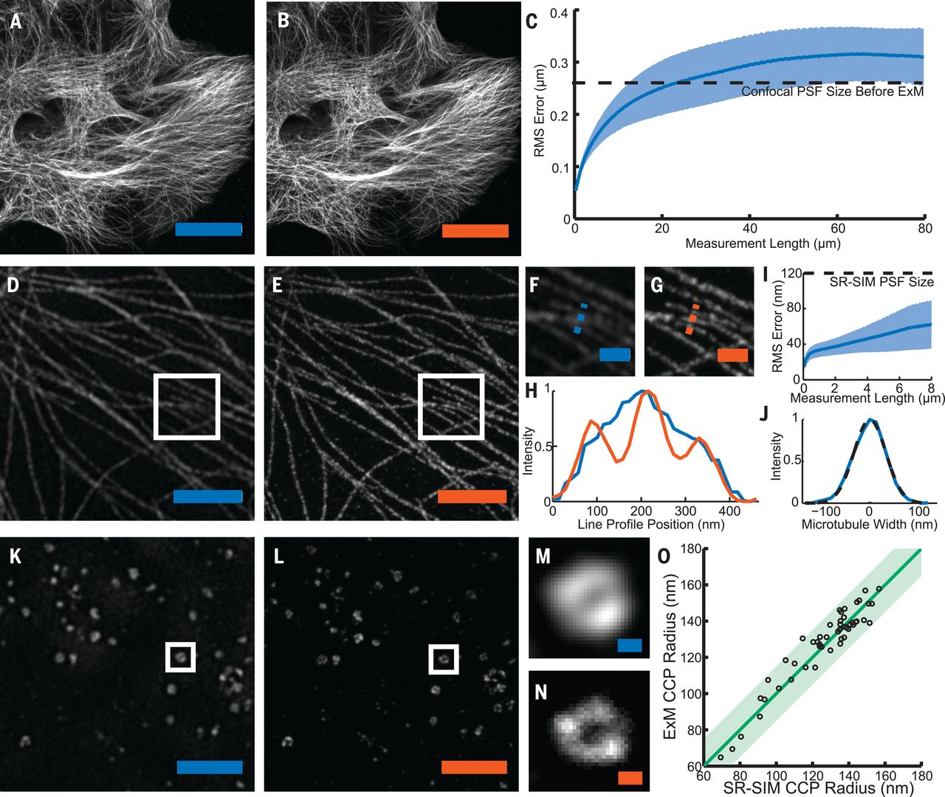
Confocal Image
Confocal Image
Microtubule
SR-SIM Image
ExM Confocal Image
Error within PSF
Microtubule
Effective resolution
~250nm/~4.5 = ~60nm
Within digitization error
Of the measurement
Clathrin-coated pit
(CCP)
Fig. 2.

Slide 18
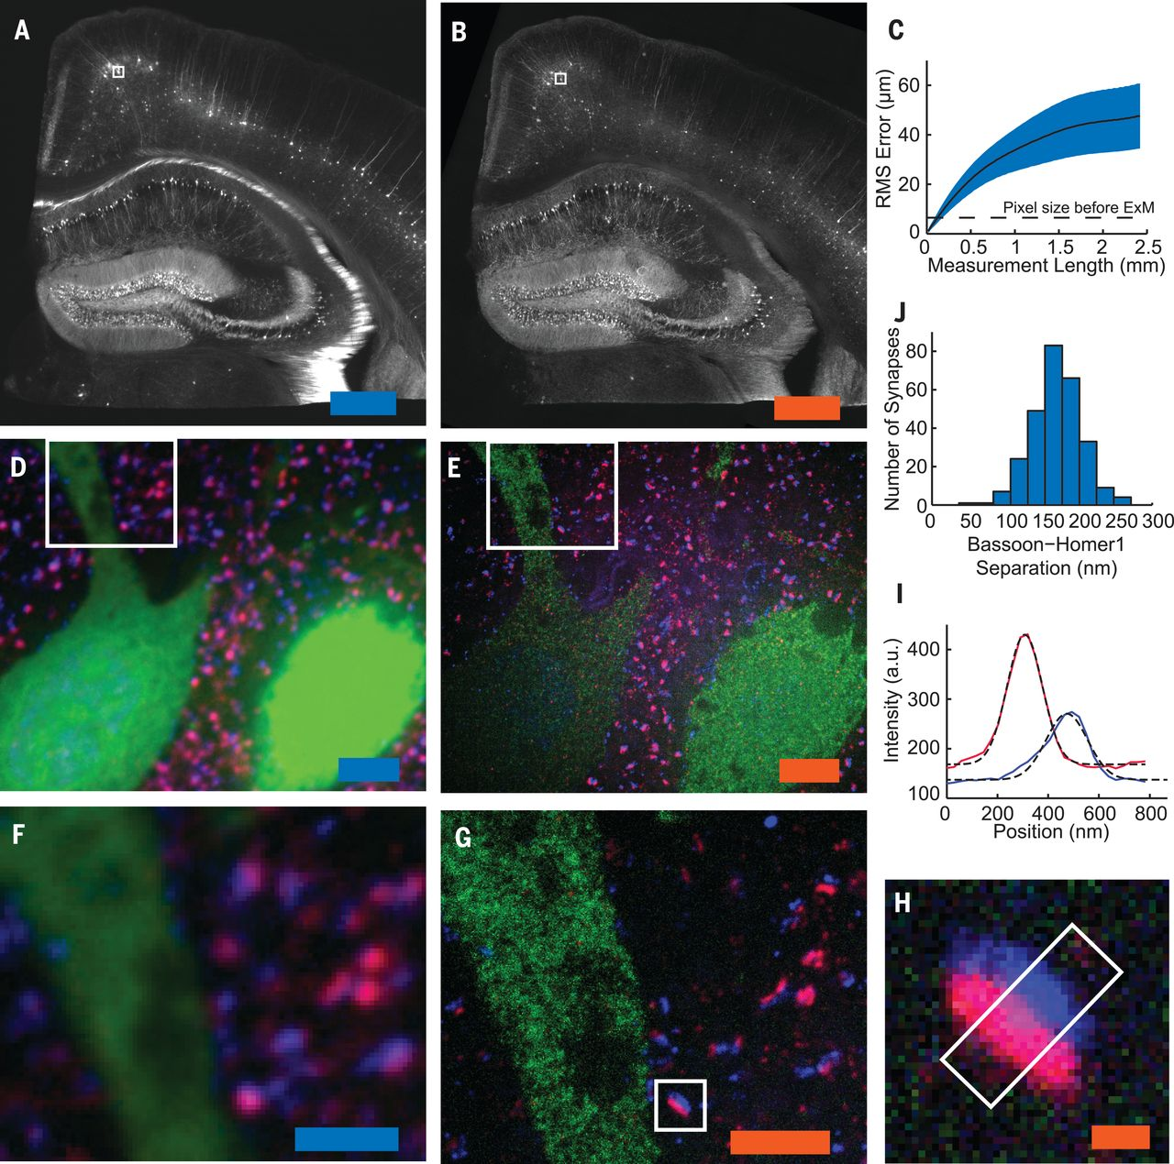
WD fluorescence
SR-SIM
Confocal
Fig. 3
Synapse
250nm

Slide 19
带有 SmartArt 的标题和内容版式
步骤 1 标题
任务说明
任务说明
任务说明
任务说明
步骤 2 标题
任务说明
任务说明
任务说明
步骤 3 标题
任务说明
任务说明
步骤 4 标题
任务说明
任务说明

Slide 20
带有表格的两栏内容版式
此处为第一个要点
此处为第二个要点
此处为第三个要点
 | 组 1 | 组 2
类 1 | 82 | 95
类 2 | 76 | 88
类 3 | 84 | 90

Slide 24
标题和图表

